Slide 1
3D design
Work to be completed week commencing 14/7/25 and homework

Slide 2
During this term you have been working on your extended project with a title of your choice.
Your powerpoint should now be complete.
If you have not finished this it must be completed before your return to school in September.
On the 3 next slides please find a check list for you to use to make sure every task is completed
Links you will find helpful
https://www.bbc.co.uk/bitesize/guides/zgtngdm/revision/1
https://www.bbc.co.uk/bitesize/guides/zc7mng8/revision/1

Slide 6
Work for week commencing 14/ 7/24
Lesson 1
Initial ideas and Rational power point slide for ideas on how you will develop an outcome based on your second artist (this is the same as you did in lessons for artist 1. See the next slide for everything which needs to be included in this slide)
10 thumbnail drawings/ parti drawings of you initial ideas
Choose your favourite 3 and do a development drawing for each one
Using the ideas you have come up with complete an A4 sized drawing of your final idea with annotations. ( see slide 8 for a good example of how this should be done and slide 9 for what you need to include )

Slide 7
I
Key words
Circles, Triangles, Rectangles, Spheres, Cuboids, Prisms
I will be creating a………
(Brief description of what you are creating, why you are doing this and vaguely what the finished item will look like)
I like the way the artist has used………..
(Talk about the formal elements and how the artist has placed/used them
Shape
Colour
Pattern
Space
Line
Texture
Perspective
Harmony etc
Key words
Harmonious
Contrasting
Primary
Subtle
Tints
tones
Rationale
Shapes
Influences from the artist
Initial Ideas
Colour Scheme
Keywords
Overlapping
Mirrored
Ornate
Decorative
Bold
Symmetrical
Arrangement
Geometric
Abstract
Pattern
Materials I will explore
Explain the materials you will try and why
Eg clay , Modroc, wire, cardboard, paper, mosaics, foamboard etc

Slide 8
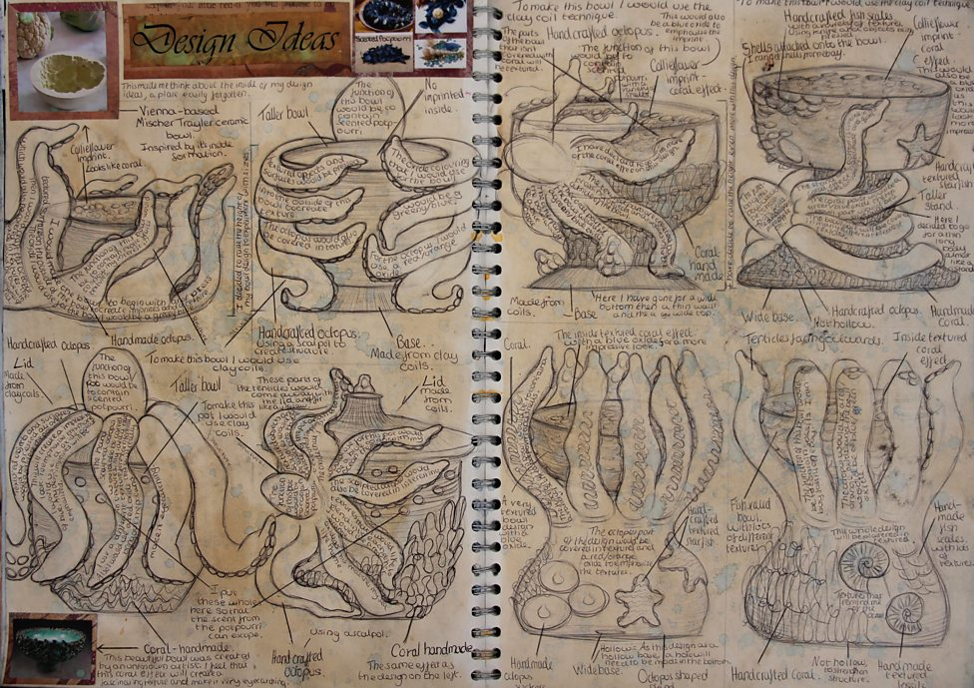

Slide 9
Annotations – what to include
To annotate your work successfully, you should explain:
what you will do and why
how you will do it, such as the techniques you will use
why you chose a particular medium or technique
how an artist/ artist work or design fits in with your project
what aspects you like
what you think you will do next

Slide 10
Lesson 2
Initial ideas and Rational power point slide for ideas on how you will develop an outcome based on your third artist (this is the same as you did in lessons for artist 1. See the next slide for everything which needs to be included in this slide)
10 thumbnail drawings/ parti drawings of you initial ideas
Choose your favourite 3 and do a development drawing for each one
Using the ideas you have come up with complete an A4 sized drawing of your final idea with annotations
( see slide 8 for a good example of how this should be done)

Slide 11
I
Key words
Circles, Triangles, Rectangles, Spheres, Cuboids, Prisms
I will be creating a………
(Brief description of what you are creating, why you are doing this and vaguely what the finished item will look like)
I like the way the artist has used………..
(Talk about the formal elements and how the artist has placed/used them
Shape
Colour
Pattern
Space
Line
Texture
Perspective
Harmony etc
Key words
Harmonious
Contrasting
Primary
Subtle
Tints
tones
Rationale
Shapes
Influences from the artist
Initial Ideas
Colour Scheme
Keywords
Overlapping
Mirrored
Ornate
Decorative
Bold
Symmetrical
Arrangement
Geometric
Abstract
Pattern
Materials I will explore
Explain the materials you will try and why
Eg clay , Modroc, wire, cardboard, paper, mosaics, foamboard etc

Slide 12
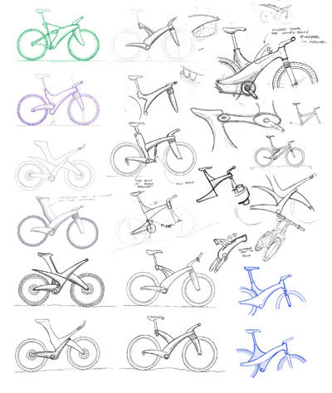
Key vocabulary
Thumbnail sketches - A thumbnail sketch is a small, quick, and rough preliminary drawing used to explore composition and ideas before creating a larger, more detailed artwork

