Slide 1
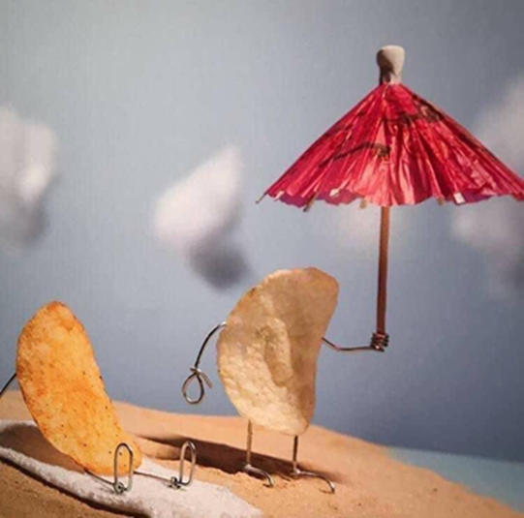
Do Now Activity:
1. What does this image show?
2. What is the creator of this work trying to convey?
3. If you had to add two speech bubbles
to this piece what would the text say?
Creator: Terry Border

Slide 2
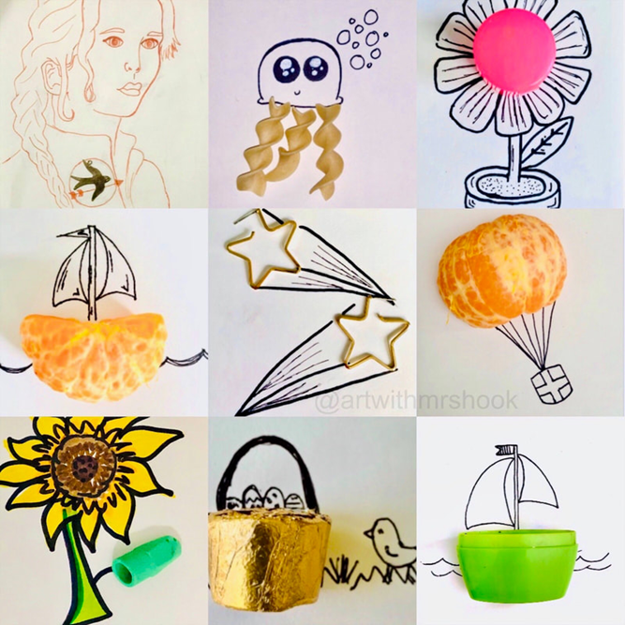
Everyday objects doodling
Challenging Students to See “Beyond”

Slide 3

According to author Julie Israel, “Creative people do not see things for what they are; they see things for what they could be.” Let us explore the pencil mark on a piece of paper or the swipe of a paintbrush across a canvas or the permanent outcomes of our sharpie pens!
Enter the inviting, whimsical, and fun work of Ecuadorian illustrator Javier Perez, also known by his professional nom de guerre, Cintascotch (@cintascotch). Taking inspiration from everyday items, he creates small and purposefully simple doodles by adding details to the space surrounding a trinket, tool, food, or other found object.
Create 10 doodles, the drawings should be no smaller than 5 per page. Craftmanship etiquette, show good form, be visually polite.
What is the difference between “inspired by” and “copied from.”
This is a great fit for distance-learning because as artists you can utilise whatever resources you have available to you at home and there is so much stylistic freedom in doodling.
Have fun! Be inspired! And be creative!

Slide 4
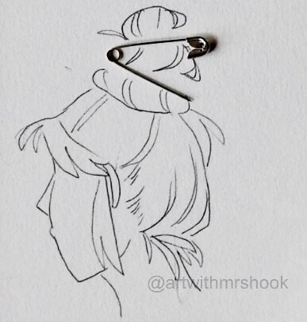
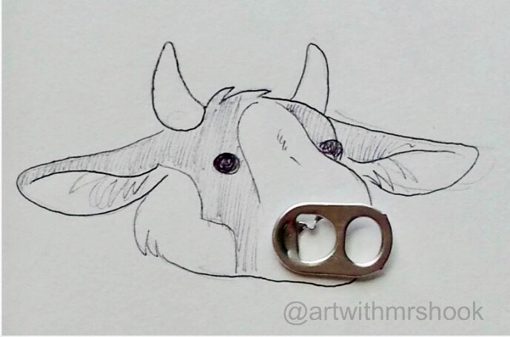
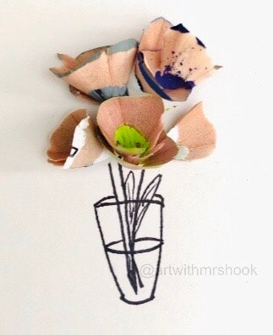
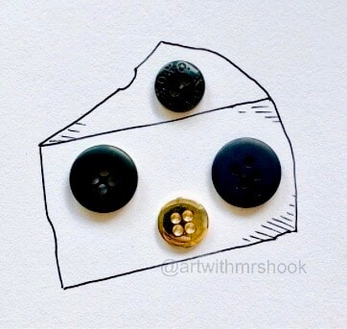
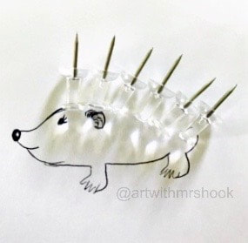

Slide 5
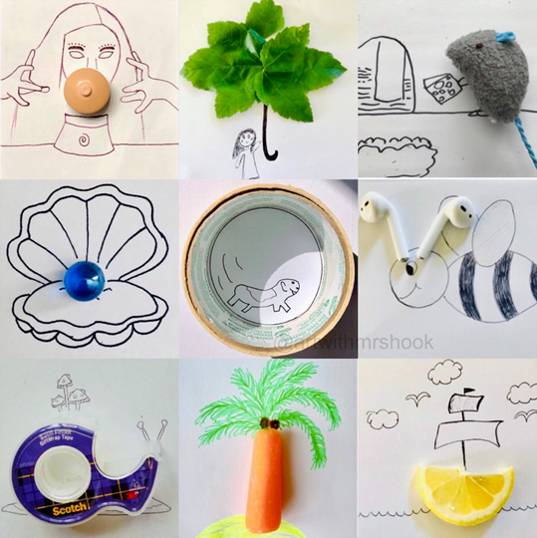
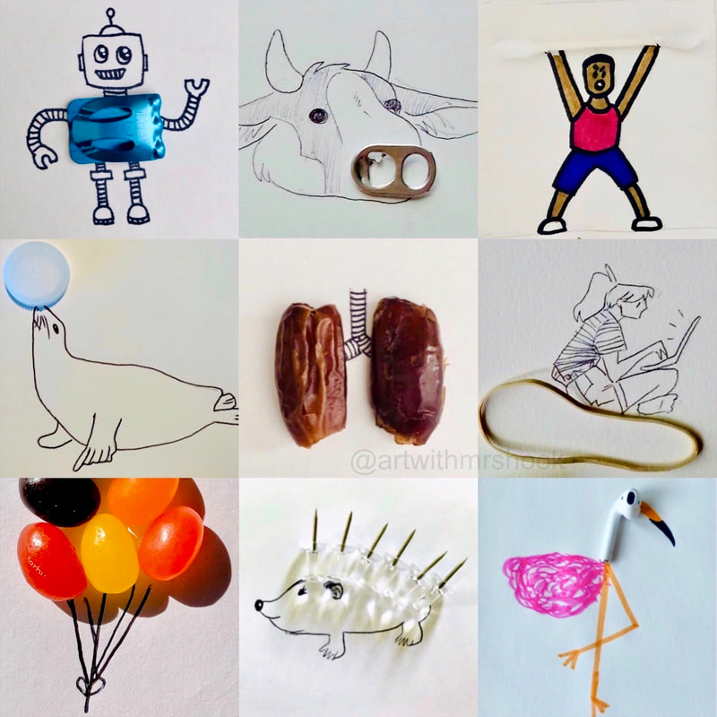

Slide 6
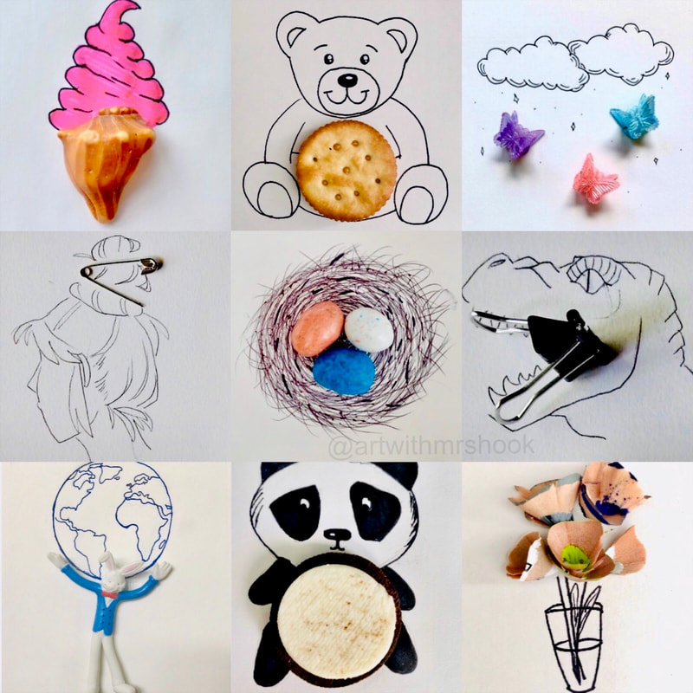
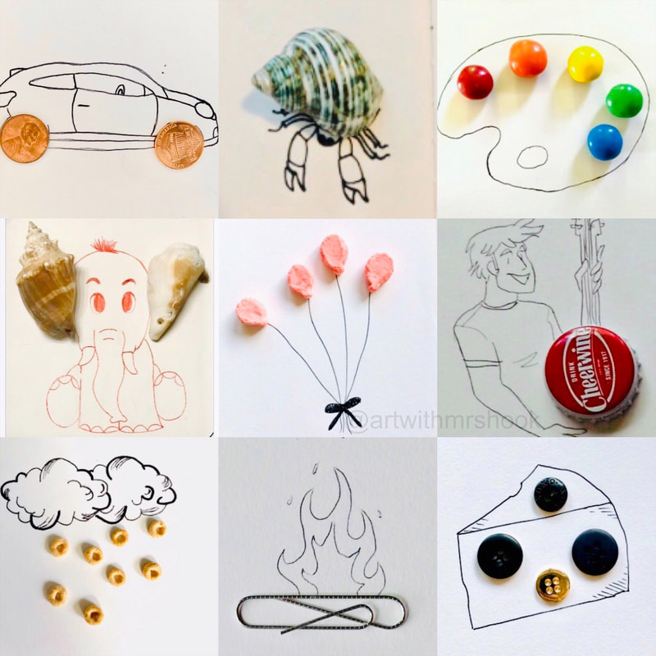

Slide 7
Attach your images here:
Or bring it in to school in September

Slide 8
Assess your work
What worked well? What did you enjoy? What does your work show?
What could you improve? What didn’t work well?
Answer here
Answer here

