Slide 1
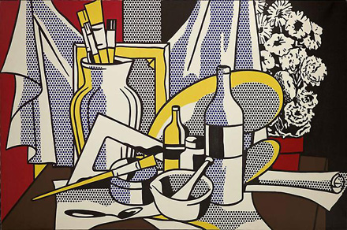
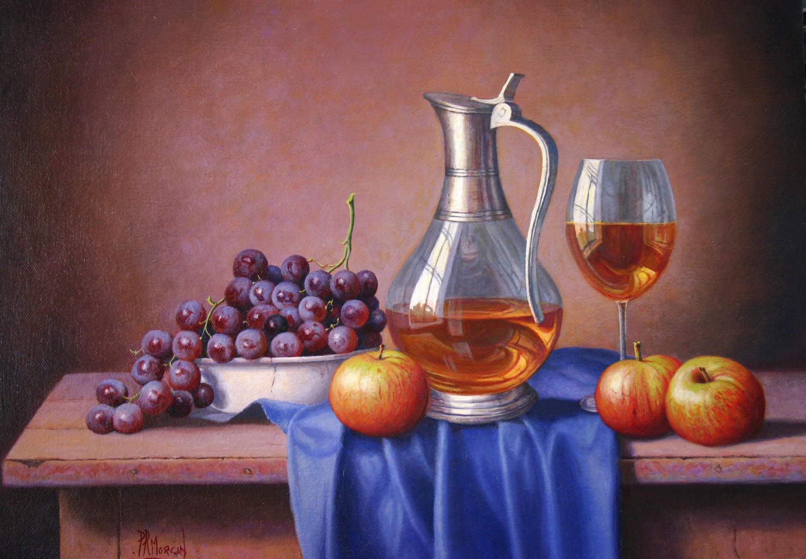
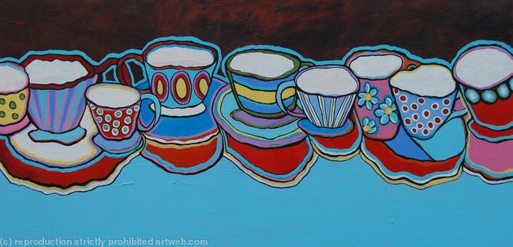
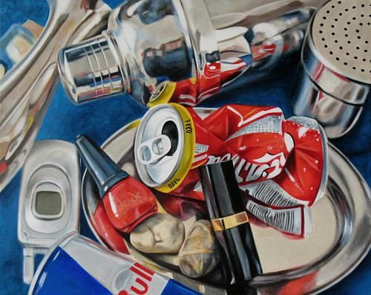
YEAR 8 ART - Still Life
DO IT NOW.
What is a still life?
Spend 5 minutes researching on the internet and find out what a still life is.
Look at lots of different examples of still life art. What objects are used? Do they have a theme? What materials have been used to create them?
Can you spot the names of any artists that produce still life art?

Slide 2
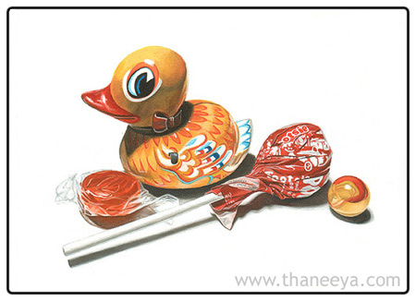
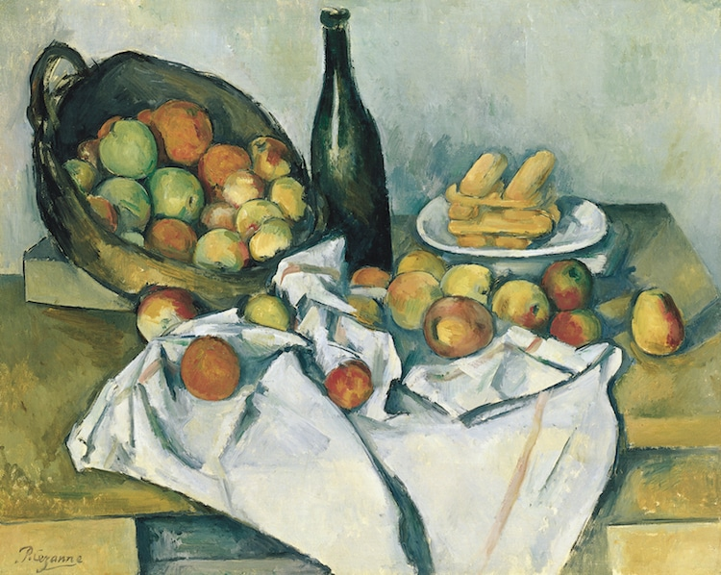
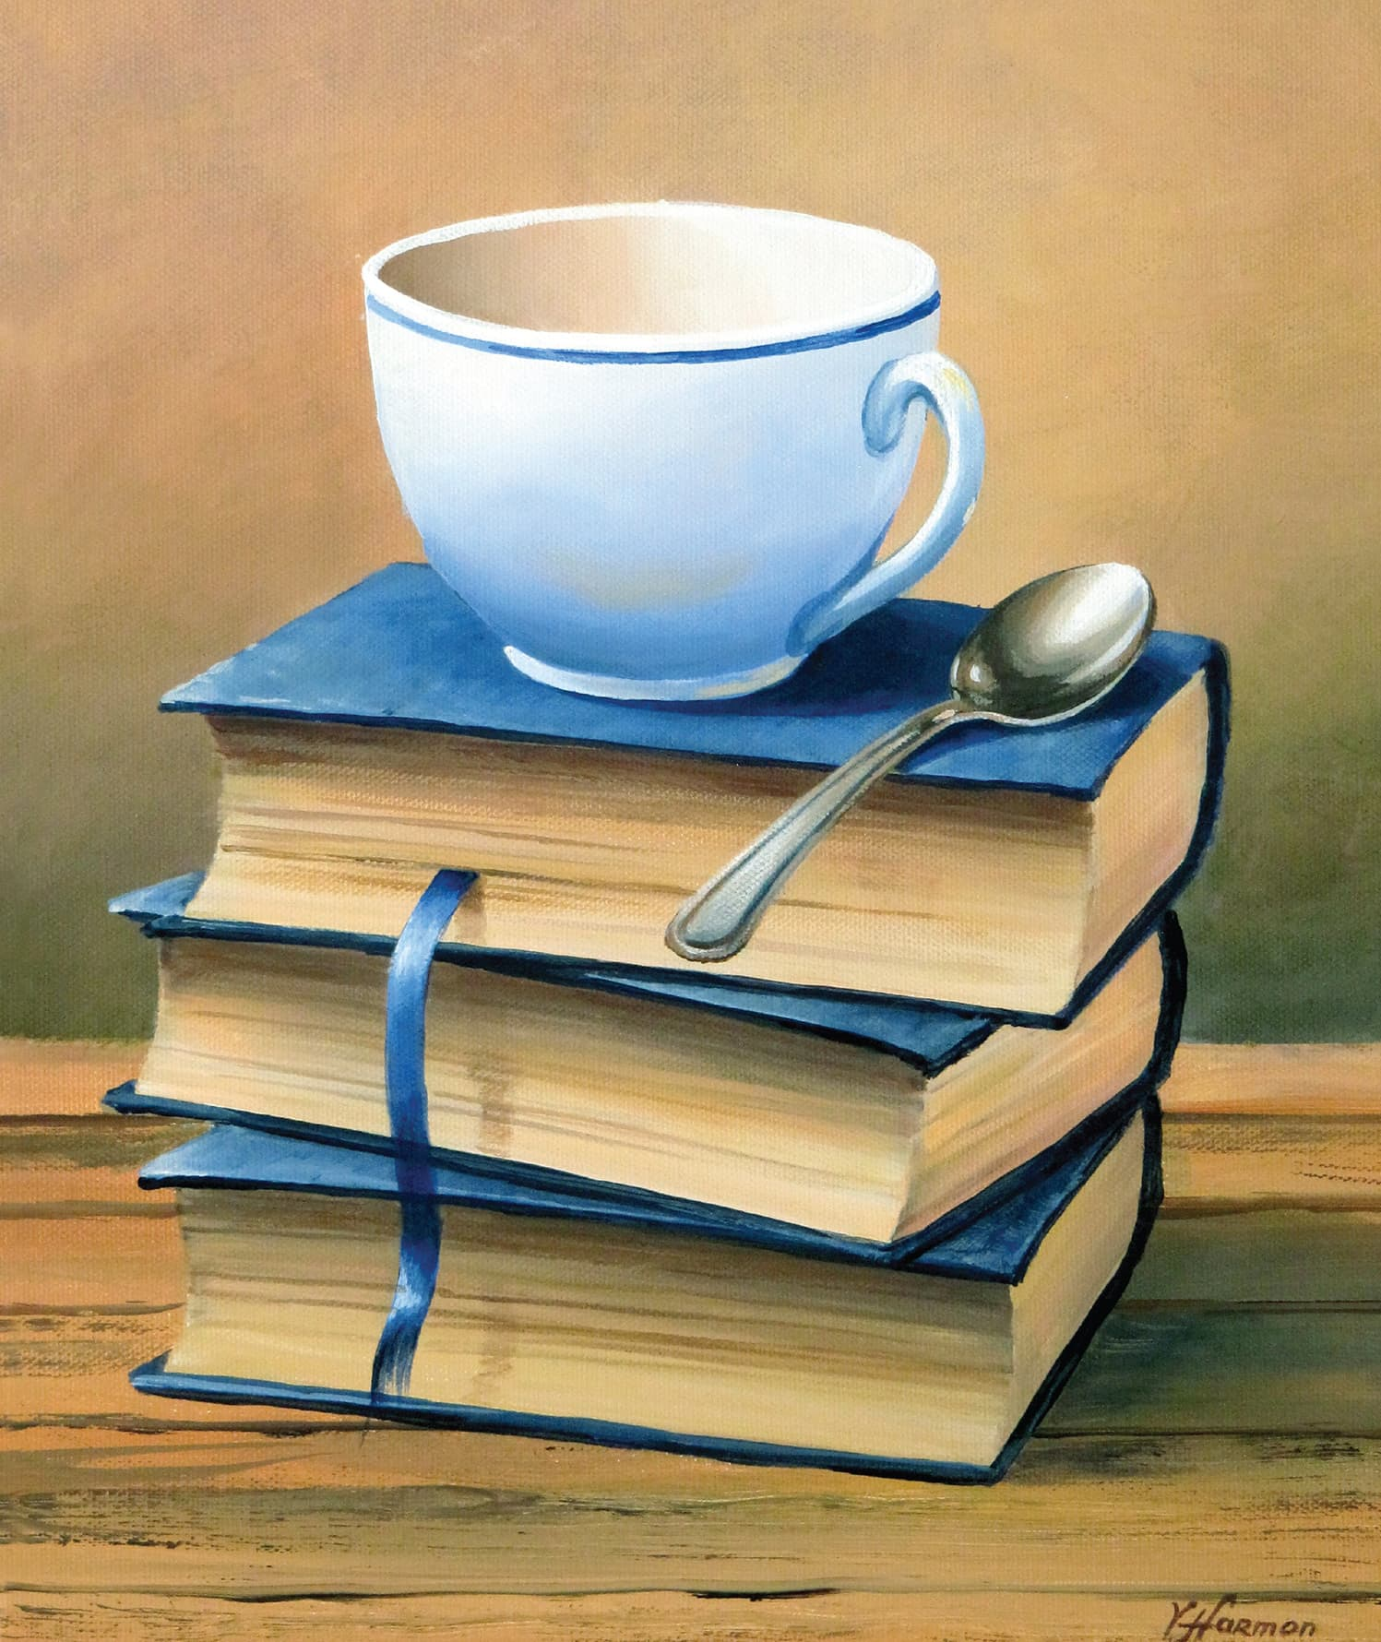
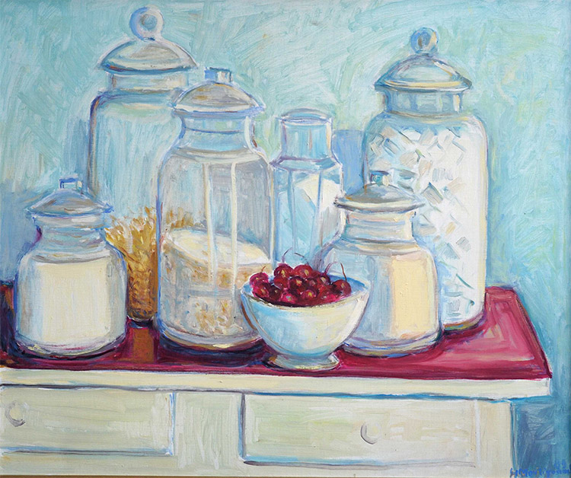
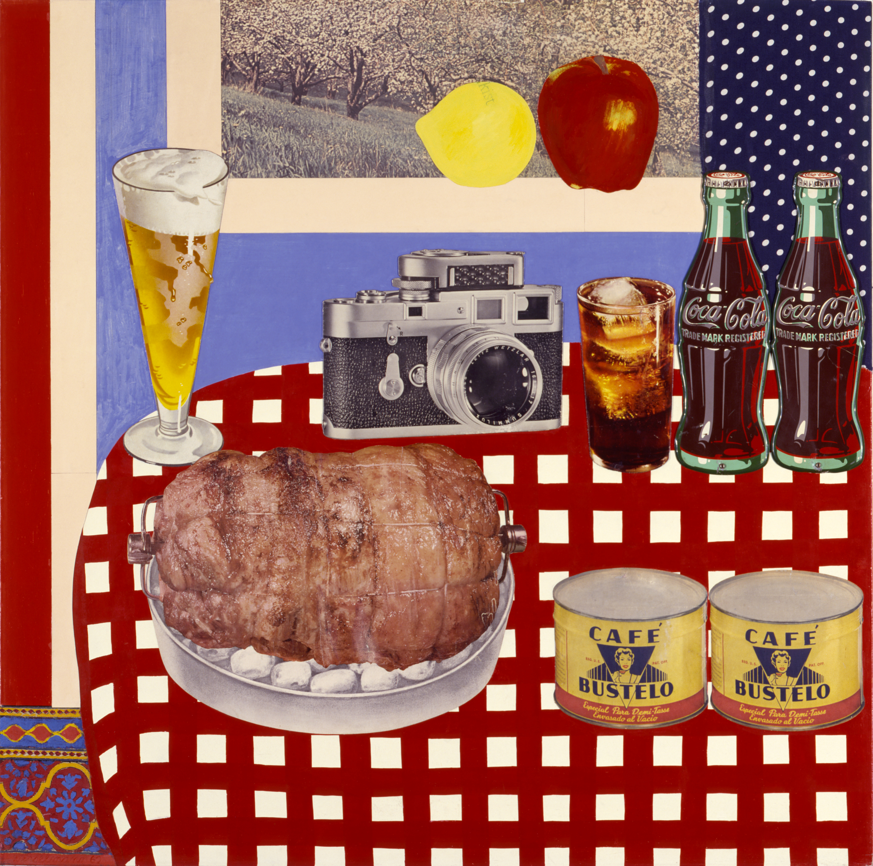
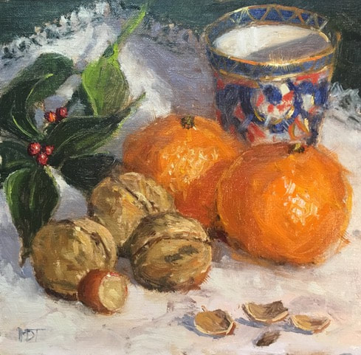
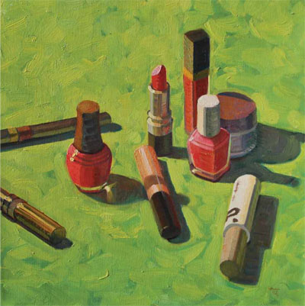
Examples of still life...

Slide 3
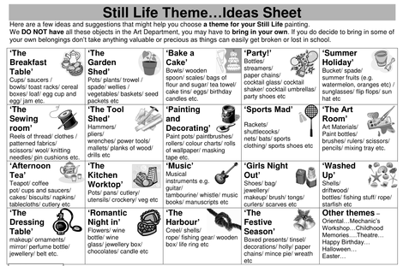
Drawing your own still life - collecting your objects..
Today you are going to produce your own still life composition. You will need to collect 3 or 4 objects from around the house – natural or manmade and arrange them in a composition on a clear surface. A white piece of paper is a good surface as you will be able to see the shapes and shadows well. Here are some ideas of themes or objects to collect, you can make it as difficult or simple as you like but remember you are going to have to draw it!

Slide 4
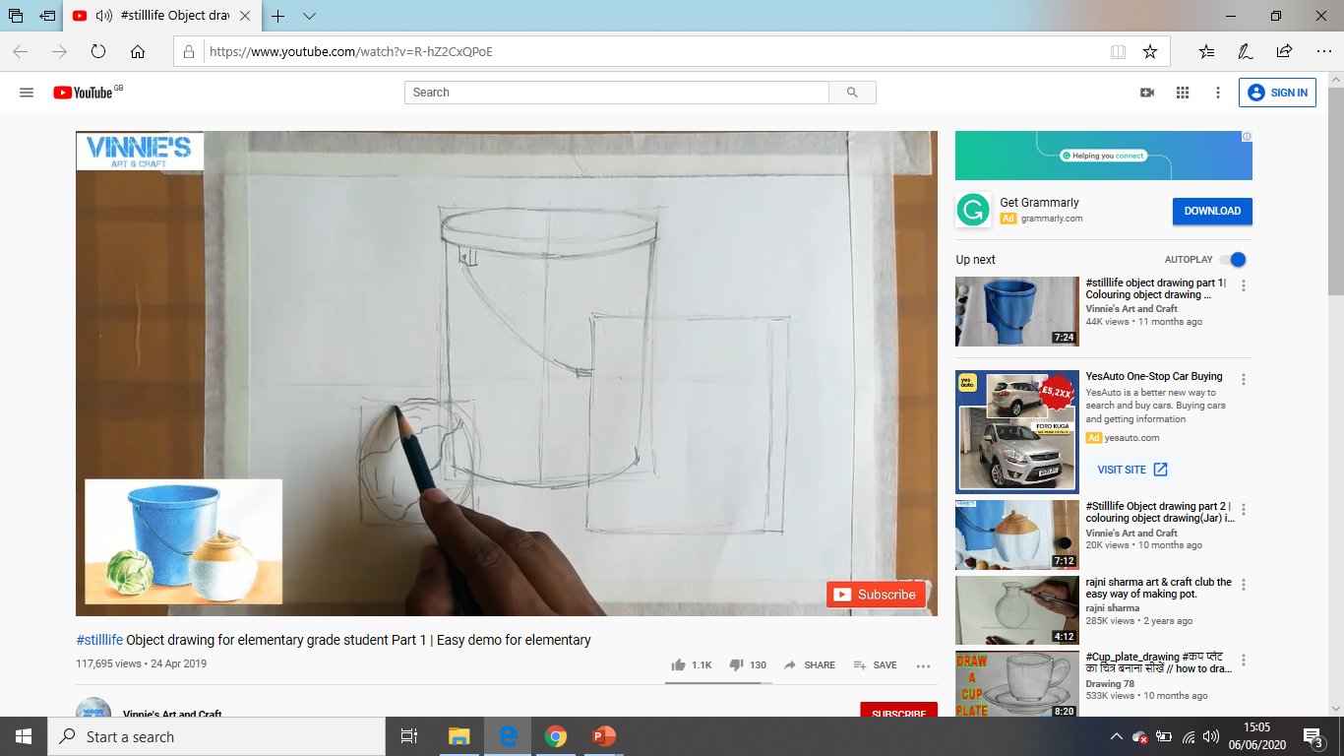
Still Life
Watch this video to help you to understand how to lightly sketch your still life out using lines and shapes.
https://www.youtube.com/watch?v=R-hZ2CxQPoE

Slide 5
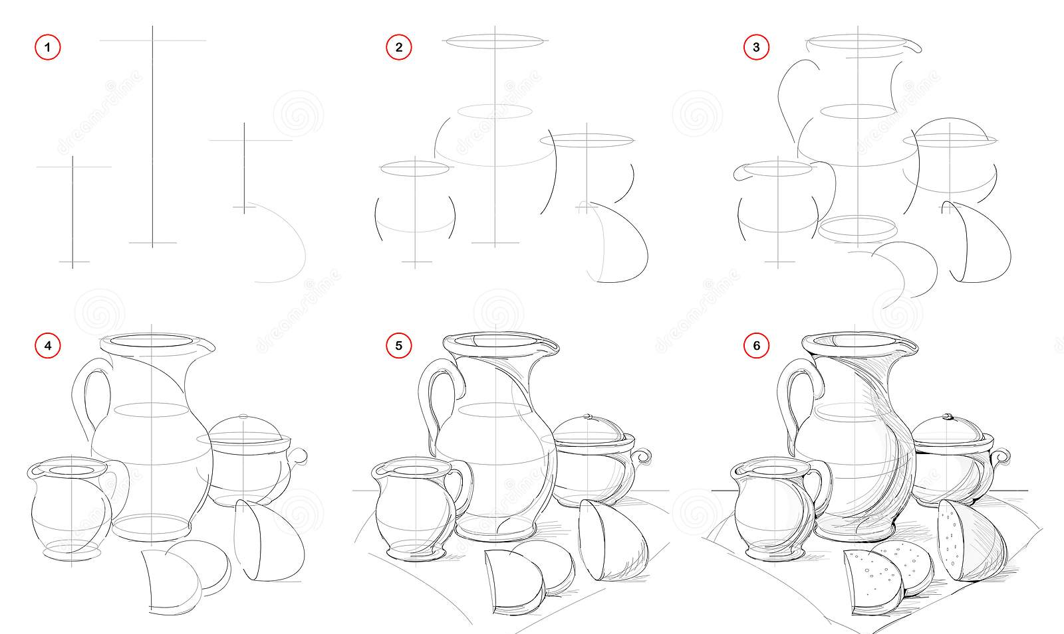
Sketching the composition step by step examples.

Slide 6
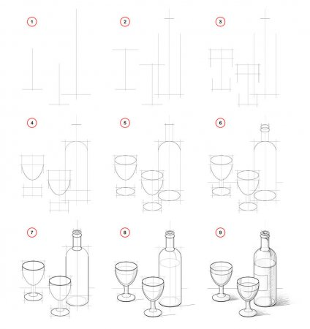
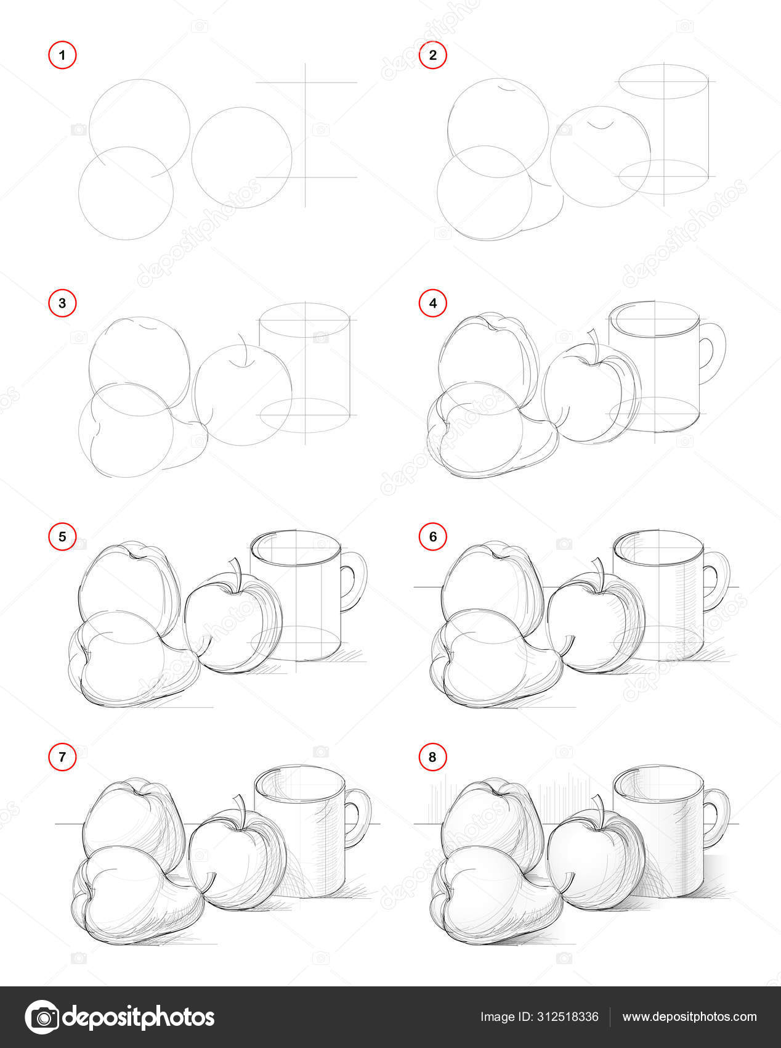
Sketching the composition step by step examples..

Slide 7
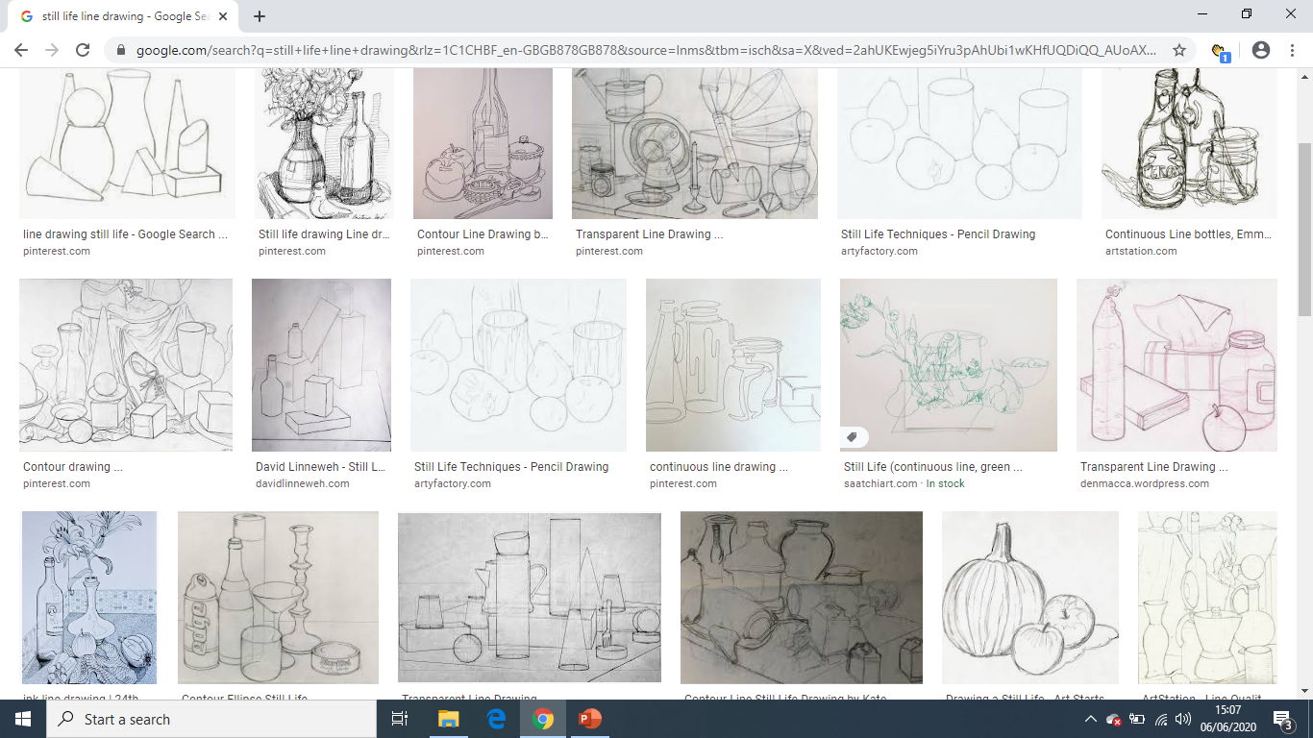
By the end of todays lesson you should have created a basic line drawing with details and shapes sketched in just like the ones on this page.
Once your drawing is complete you may add any media you like… Pencil shading, coloured crayon, pastels or even paint!

