Slide 1
Extended Do it Now
1) What do the letters CPU stand for?
2) What is the role of the CPU?
3) What happens during the ‘fetch’ part of the fetch-decode-execute cycle?
4) What happens during the ‘decode’ part of the fetch-decode-execute cycle?
5) What happens during the ‘execute’ part of the fetch-decode-execute cycle?
6) The speed of the CPU is measured in what? ______
7) 2 Ghz means there are _______________ instructions processed per __________.
8) What is the benefit of having a ‘dual core’ CPU?

Slide 2
Extended Do it Now
1) Central processing unit
2) Process input, store data and output results
3) Gets the next instruction from the computer's memory
4) Breaks down/deciphers what the program is telling the computer to do
5) carries out the requested actions
6) Hertz
7) 2 Ghz means there are 2 billion instructions processed per second
8) Run multiple programs at once

Slide 3
Part 1 - Software & Computer Systems

Slide 4
Hardware and software
Hardware – the physical components on your computer – e.g. CPU, Keyboard, Monitor.
Anything related to your computer that you can see and touch is HARDWARE
Software – computer programs that run on the hardware.
OPERATING SYSTEM (OS)
Microsoft Windows
Android
IOS

Slide 5
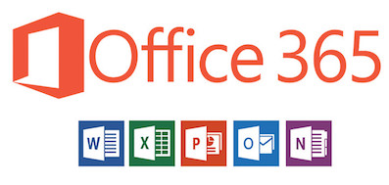
Application software
An application program is a computer program designed to carry out a specific task other than one
Examples
Micrsoft office- Word, PowerPoint, Excel
Email
Mobile apps e.g., snapchat, Instagram, TikTok

Slide 6
Operating Systems
An operating system is system software that manages computer hardware and software resources.
Examples
Windows
iOS
Android

Slide 7
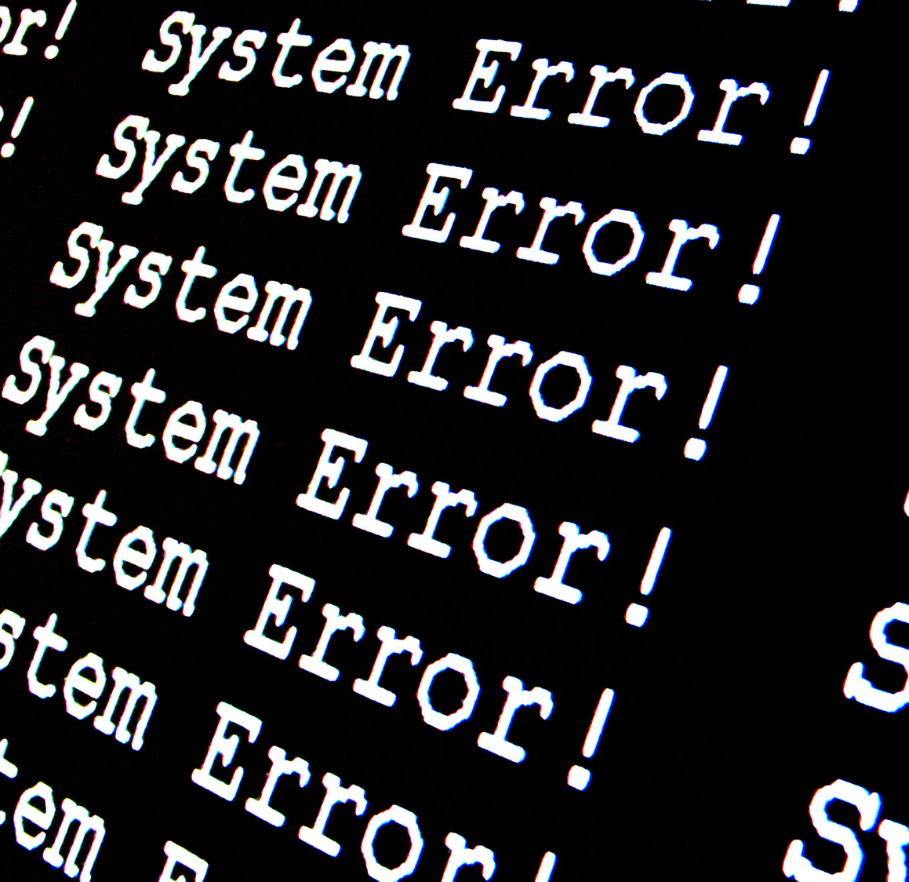
Functions of operating systems
1) Manages and controls hardware
2) Allows installation software to be installed on the hardware.
3) Manages storage / memory
4) Deals with errors
5) Provides the user interface used to interact with the computer

Slide 8
Knowledge Check
1) Operating Systems are Hardware (True/False)
2) Microsoft Word is an Operating System (True/False)
3) Name three Operating Systems
4) Hardware – the ___________ components on your computer – e.g. CPU, _____________, monitor. ___________– computer programs that run on the hardware. These include Operating ________and ________ software
Software, Application, Systems, Keyboard, Physical

Slide 9
USER
OPERATING SYSTEM
HARDWARE
APPLICATION
Relationship
The user is using applications that run on top of the operating system which runs on top of hardware devices.

Slide 10
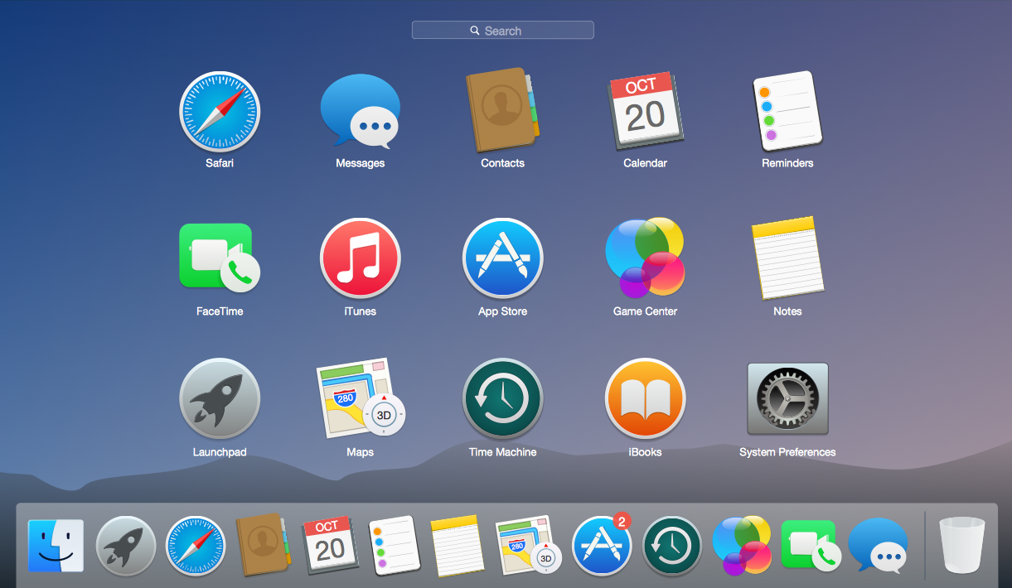
Types of user interface- Graphical User interface
Graphical user interfaces uses images and icons for the user to access

Slide 11
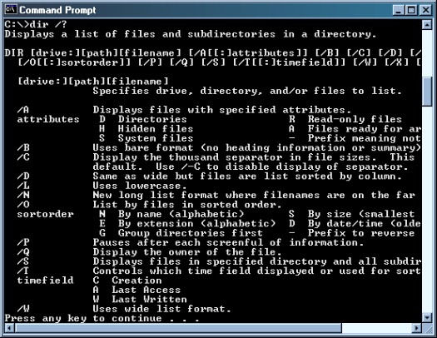
Types of user interface- command line
Command line interfaces uses commands/instructions to work.

Slide 12
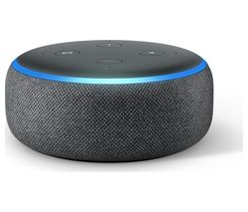
Types of user interface- sensor
Sensor user interfaces uses senses such as voice to activate and work

Slide 13
Task
Explain what an operating system is?
Give an example of a device controlled by the Operating System.
Correct this diagram
4) Explain what user interfaces are with two examples?
5) An operating System manages s___________ and M____.
APPLICATION
HARDWARE
OPERATING SYSTEM
USER

Slide 14
Task
6)List the functions of the Operating System that we have covered.
7) Describe 3 different software applications that you have used on the school computers or at home on your mobile
For each:
What is it called?
What did it allow you to do?
List some of the tools that you used in it.

Slide 15
Part 2 – Utility Software

Slide 16
Do it now
Define the term software
Give two functions of the operating system.
Give two examples of an operating system.
Define the term hardware

Slide 17
What is utility software?
Utility software is software designed to help to analyse, configure, optimise or maintain a computer.
It is used to support the computer system - in contrast to application software, which is aimed at directly performing tasks that benefit ordinary users.

Slide 18
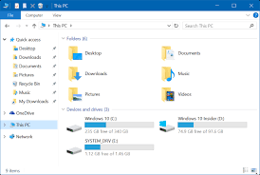
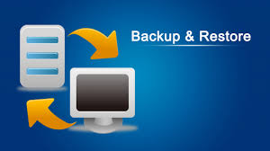
File Explorer
Backup/Restore
Create files, folders
Copy, move, rename & delete files;
Organise documents and files;
Search for documents on your computer
Make separate copies of files and documents in case the originals are lost, damaged or deleted
Restores lost, damaged or deleted files to your computer from the backup location

Slide 19
Anti-Virus
Encryption & Compression
Scans files on your computer, identifying malware and removing it.
Protects your computer from online threats when surfing the Internet
Encryption scrambles data so it cannot be read by another computer without a key.
Protects your files so that only you can open them.

Slide 20
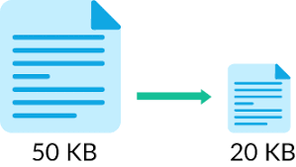
Compression
Compression utilities - ‘squash’ files to make them smaller. This makes them take up
less space.
Smaller files can be sent more quickly

Slide 21
Task
1) You are worried you might accidentally delete your files. What software utility should you use and why?
2) List 3 features of a file-explorer utility.
3) What is the difference between compression and encryption utilities?
4) Give one good reason to compress a file.
5) Explain the purpose of anti-virus software. Why is it needed?

Slide 22
Review
Explain the difference between hardware and software?
What is application software?
What is an operating system with an example?
Explain what utility software is with an example?

