Slide 1
Year 9 Art
The surrealism project.
DO NOW - Spend 5 minutes looking on the internet at surreal art. Look at the work of Salvador Dali, Rene Magritte and Vladimir Kush.
This will refresh your memory and should give you ideas of what you could use in your work.
Write down a list of things you spot; colours, features, metamorphosis, melting, dripping, distorted etc.

Slide 2

MAIN TASK
Over the next few slides are tasks linked to the ‘Surrealism’ Project we have been studying in class.
Select your favourite and complete in any media you wish on A4 paper.
I recommend you concentrate on practicing your shading with pencil or coloured crayons. Think about where the light is coming from and add dark and light tones. Focus on quality and detail in your work.

Slide 3
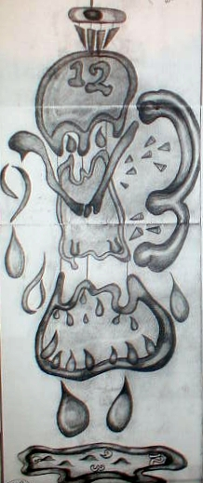
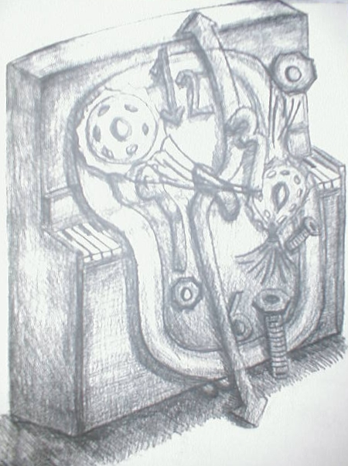
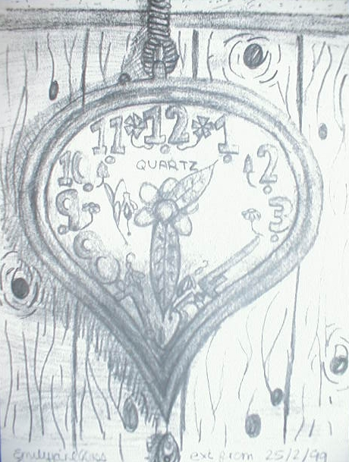
Create a detailed pencil shaded drawing of a:-
TITLE - ‘Surreal’ view of a watch / clock. Focus on detail and add shading.

Slide 4
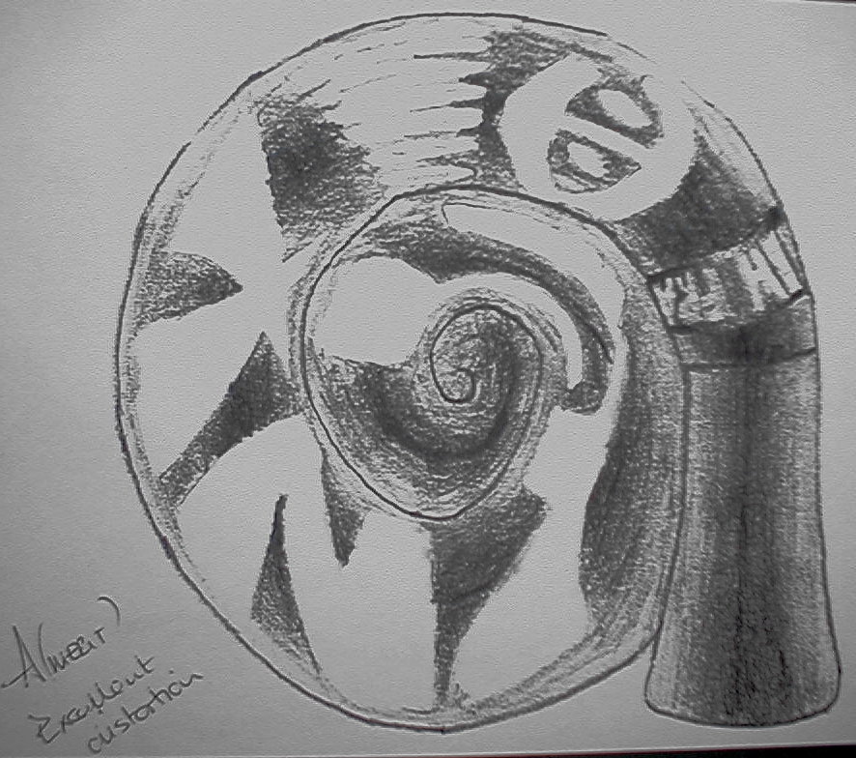
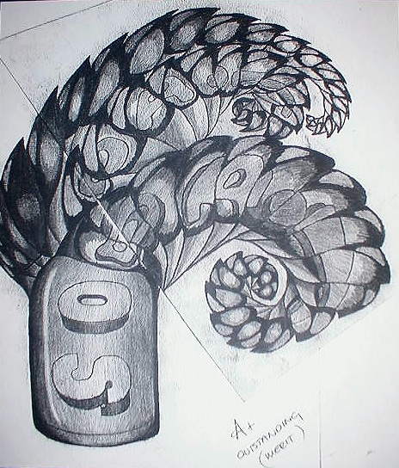
Create one part real / part distorted drawing (pencil shaded) of either a JAR – CAN – BOTTLE etc.
TITLE – ‘Distorted Container.’
Draw any type of container with a label ( lettering / illustrations ) to help create the effect of distortion.

Slide 5
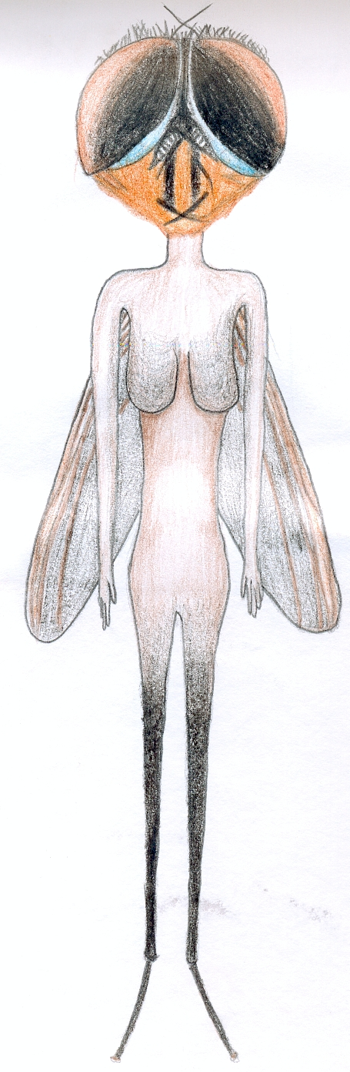
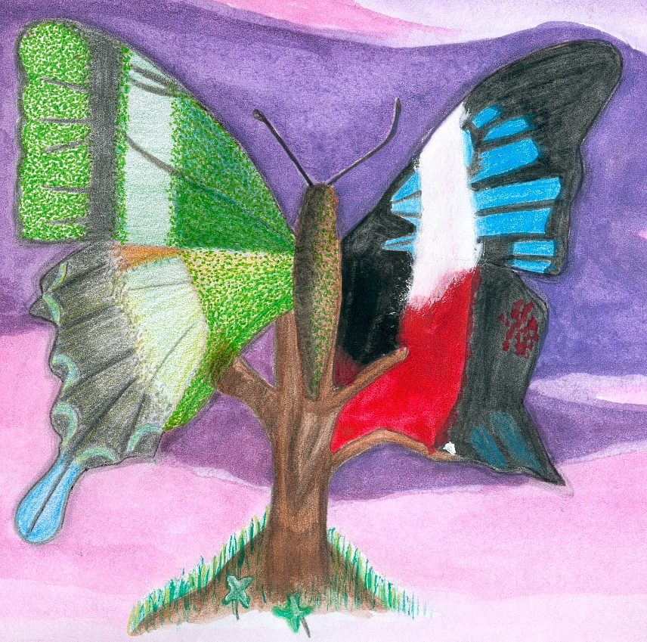
Furthering the idea of metamorphosis, create a new species made up of parts of animals and natural forms.
Create one detailed colour / pencil shaded drawing:-
TITLE – ‘New Species.’

Slide 6
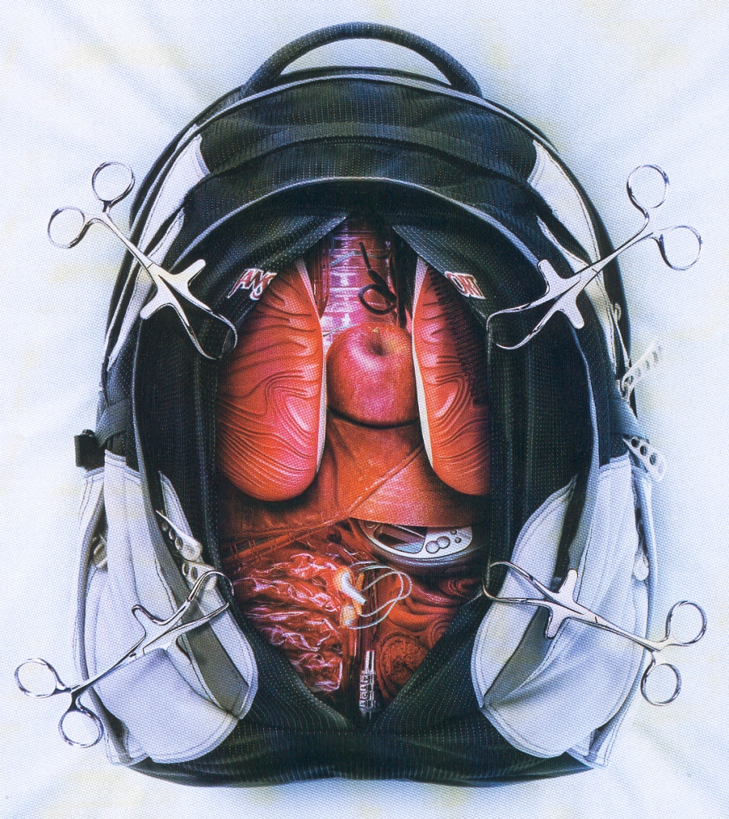
Create one realistic drawing of a pencil case, school bag, rucksack etc.
TITLE – ‘Is it Real?’
Give the image a hint of
surrealism e.g. drawers
as pockets, railway track
as a zip, gates as buckles
etc.

Slide 7
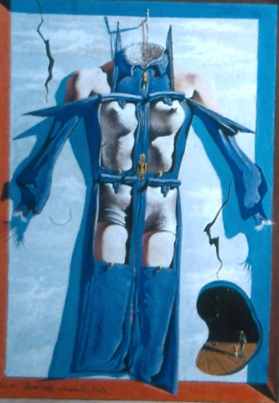
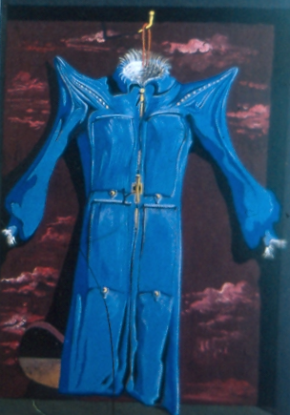
Design an outfit suitable for Salvador Dali to wear at the launch of his exhibition. Make it as strange and surreal as possible and include his work and trademarks as part of your design.

Slide 8
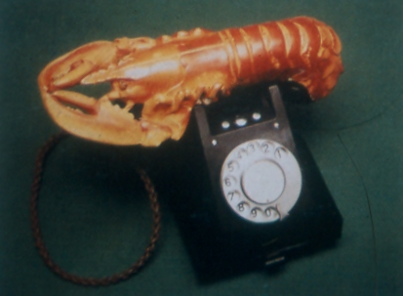
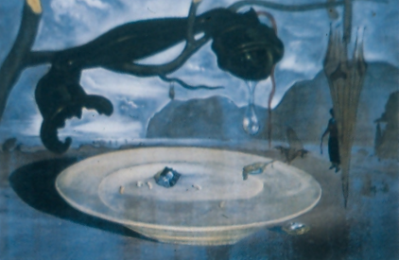
Create drawing of a ‘Surreal Telephone’.
Use colour or pencil shading to enhance your work. Base your decoration on Real / Surreal ideas.

Slide 9
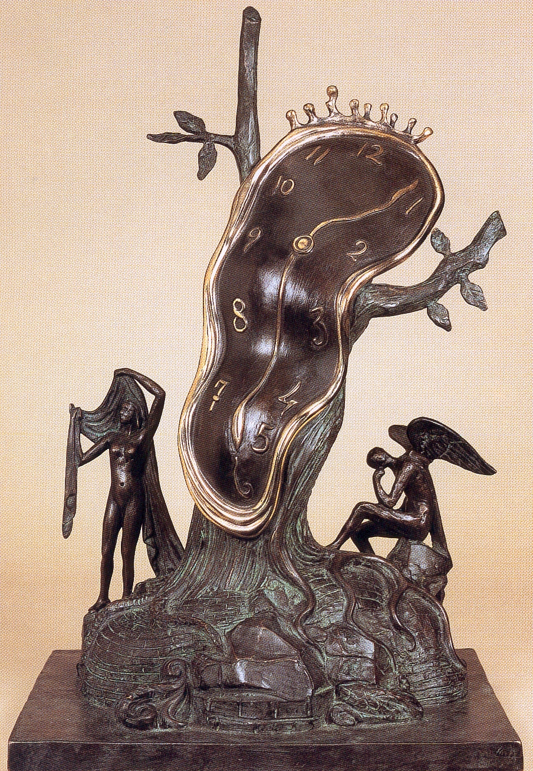
Create a design for a sculpture based on the work of Salvador Dali and the Surrealism Art Movement. Ideas could be based on:-
- items / scenes from Dali’s work
- real / surreal drawings
distortion of image
- metamorphosis
- rendering
Explain your ideas.

Slide 10
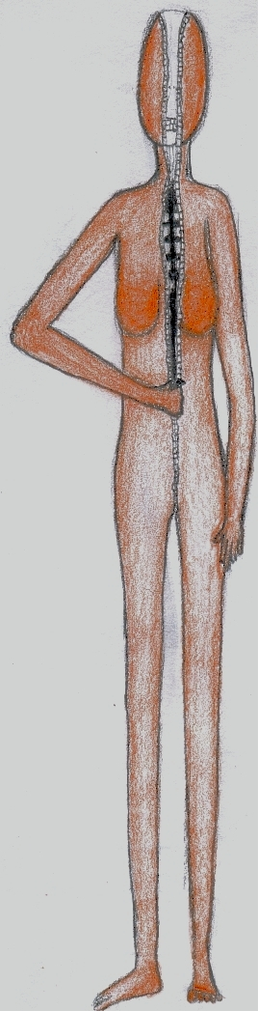
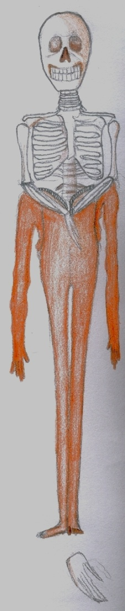
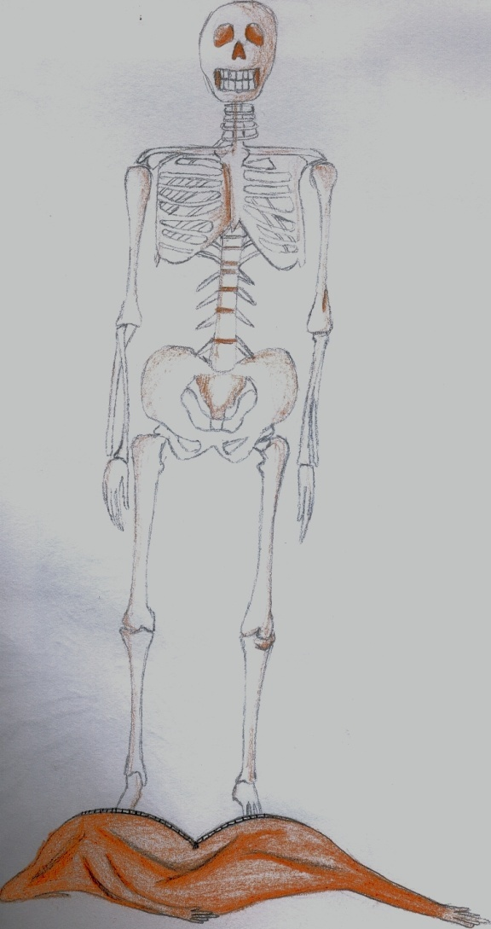
Inside out....
Create one detailed colour / pencil shaded drawing showing:-
TITLE:
‘Inside Out’
Draw an object
of your choice,
part - normal /
part ‘unwrapped.’

Slide 11
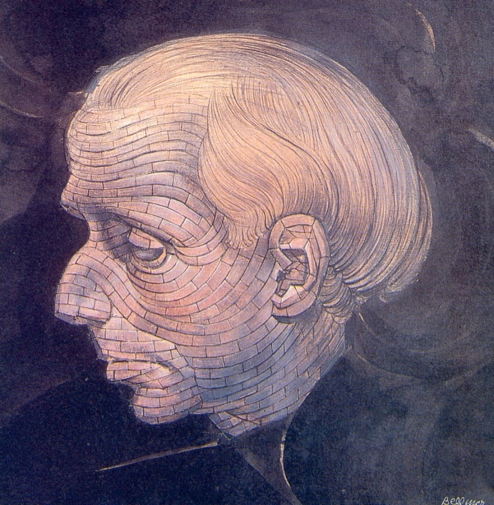
Create one detailed colour / pencil shaded drawing of:-
TITLE – ‘Surreal Rendering of an Image’
Draw the outline of an object e.g. shoe.
Render in a texture of your choice e.g. stone, wood, fur, brick etc.

